Slide 1

- because every second matters in saving a life.
ELECTRO-SAPIENS | Hackathon 2025 | HARDWARE

Slide 2

Problem Statement :
In hospitals and old age homes, nurses or caretakers cannot continuously monitor every patient’s or elderly one’s vital signs, and even a brief delay in detecting critical changes like low oxygen levels, irregular ECG, or sudden falls can lead to life-threatening situations. There is a need for a reliable, real-time health monitoring system that can instantly alert caretakers to emergencies without depending on continuous internet connectivity.

Slide 3

Why It’s Important: Timely detection of critical health changes can mean the difference between life and death. By providing immediate alerts to caretakers, such a system reduces human error, ensures faster medical response, and helps prevent avoidable fatalities, especially in environments where one nurse must care for multiple patients simultaneously.

Slide 4
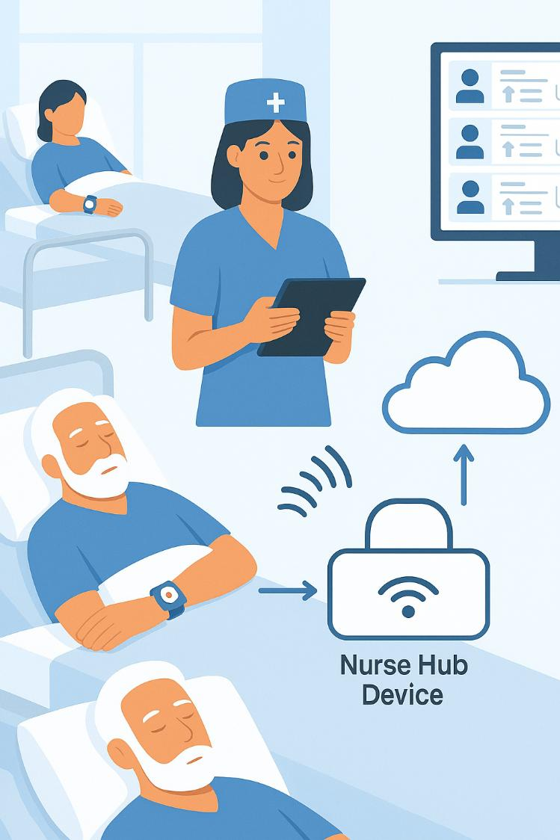
Proposed Solution :
Vital Watch provides a smart and efficient way to continuously monitor patients’ health without requiring constant manual supervision. Each patient wears a Vital Watch that tracks key health parameters such as oxygen level, ECG, blood pressure, and fall detection. These watches communicate wirelessly with a nurse’s device using the ESP-NOW protocol, which allows real-time data transfer without needing Wi-Fi or internet.

Slide 5
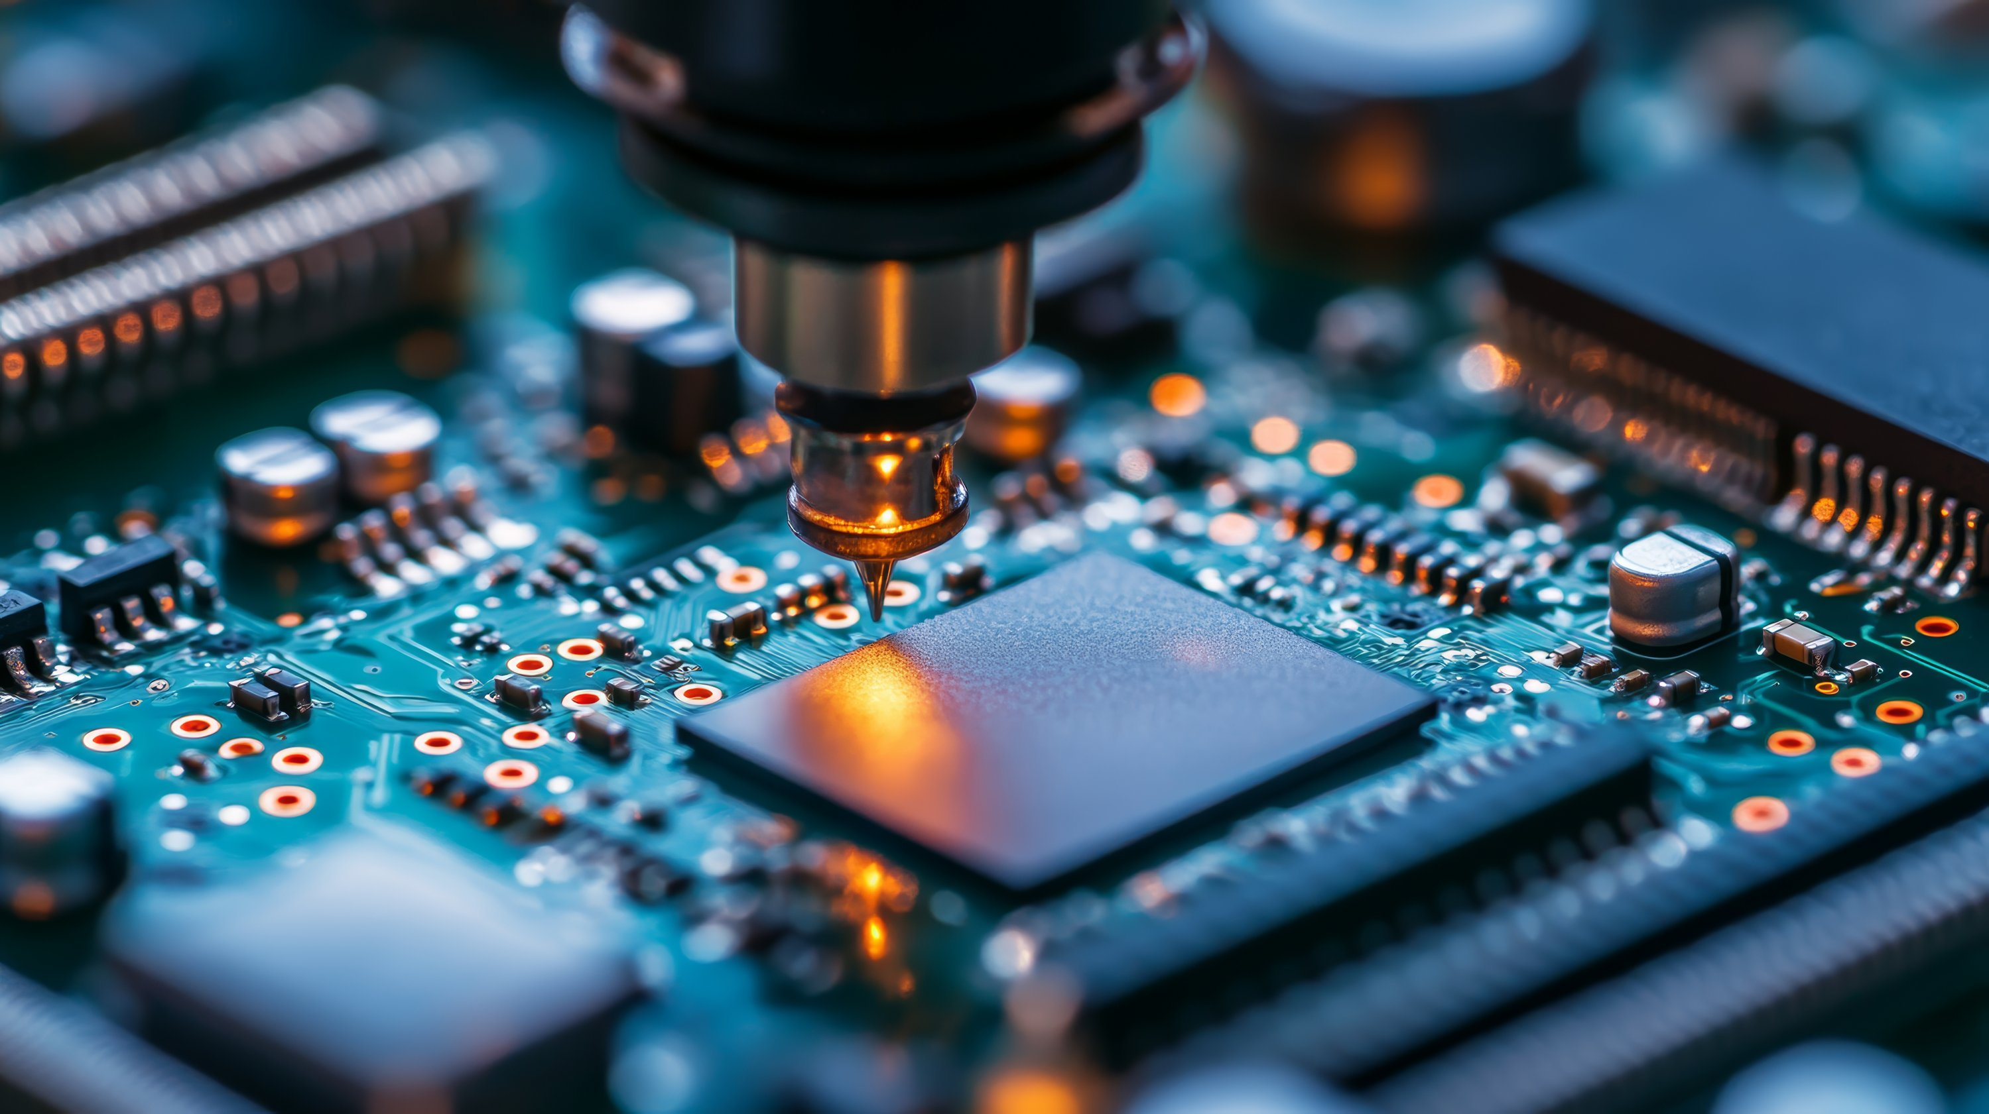
COMPONENTS

Slide 6
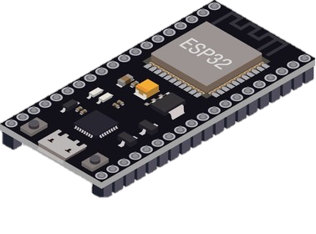
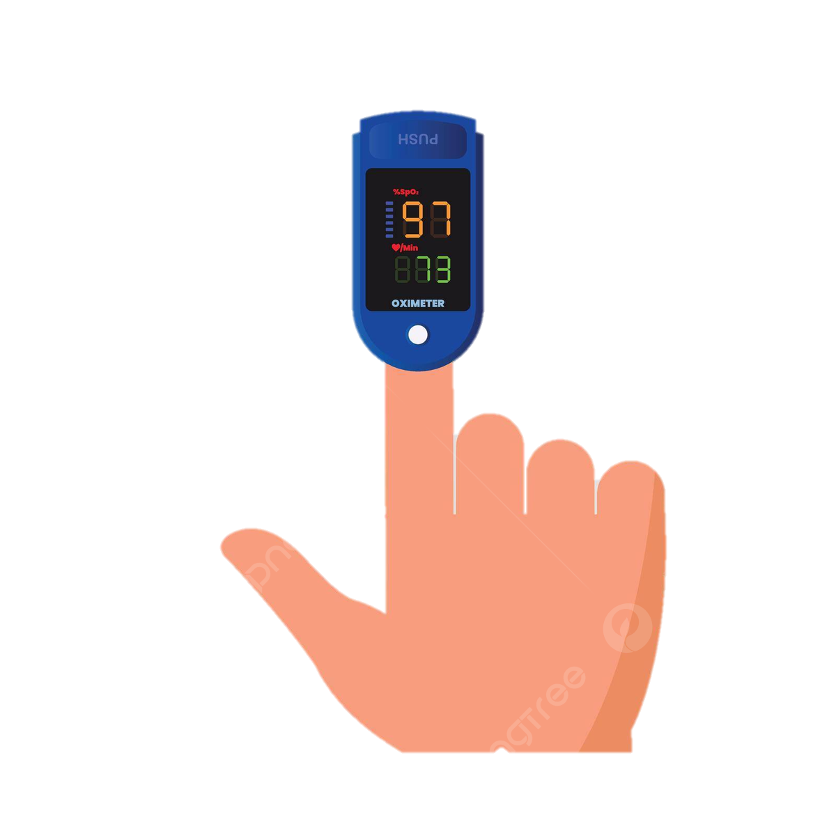
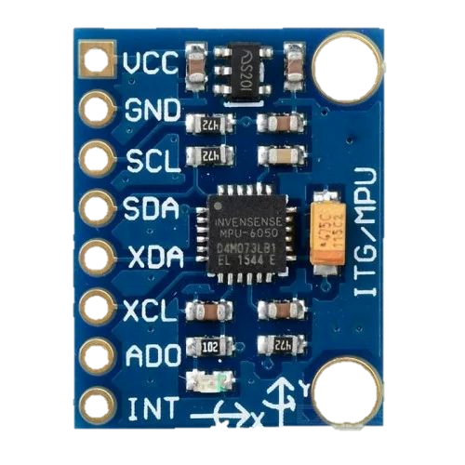
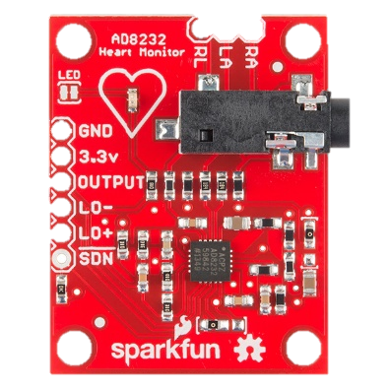
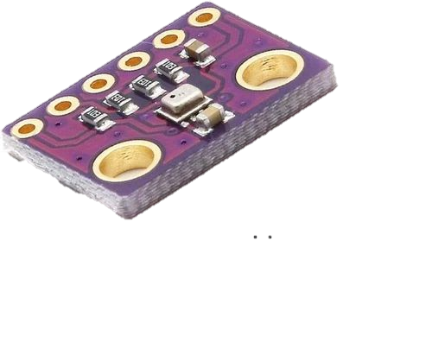
ESP32 Microcontroller :
Central hub for managing communication between the wearable devices and processing.

Slide 7
Gyroscope :
A gyroscope sensor measures angular velocity (rotation rate) in different directions (X, Y, Z axes). For fall detection, it works alongside an accelerometer to identify sudden changes in body movement and orientation.

Slide 8
BMP280 Barometric pressure sensor:
Measures ambient pressure and temperature , which can be used to detect altitude changes (useful for fall detection)and environmental conditions.

Slide 9
SpO2 sensor :
Monitors the user’s blood oxygen levels to detect potential hypoxia (Low oxygen levels).

Slide 10
AD8232 ECG sensor:
Measures the user’s heart activity and helps monitor ECG signals to detect irregular rhythms (arrhythmias).

Slide 11

⚙️ Technologies Involved

Slide 12
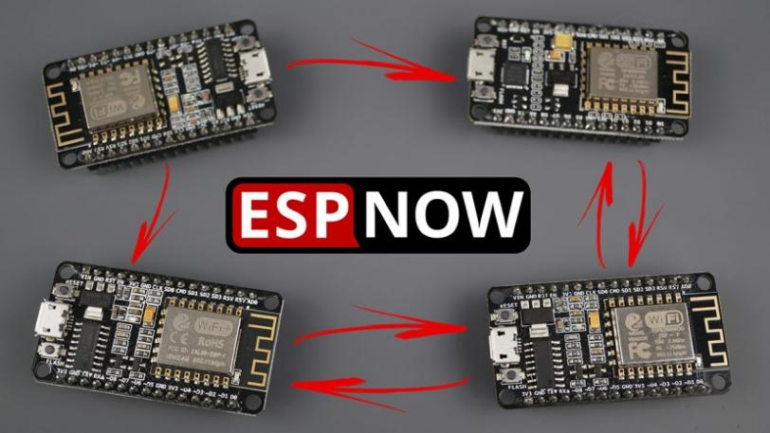
📡 ESP-NOW Protocol
🌐 Wi-Fi Connectivity
🔋 Power Management System
A low-power, peer-to-peer wireless communication protocol developed by Espressif. It allows multiple ESP32 devices to exchange data instantly without needing Wi-Fi or an internet connection. This ensures real-time monitoring and ultra-fast alerts in local environments.
💾 Embedded Firmware – Arduino IDE
🖥️ EasyEDA

Slide 13
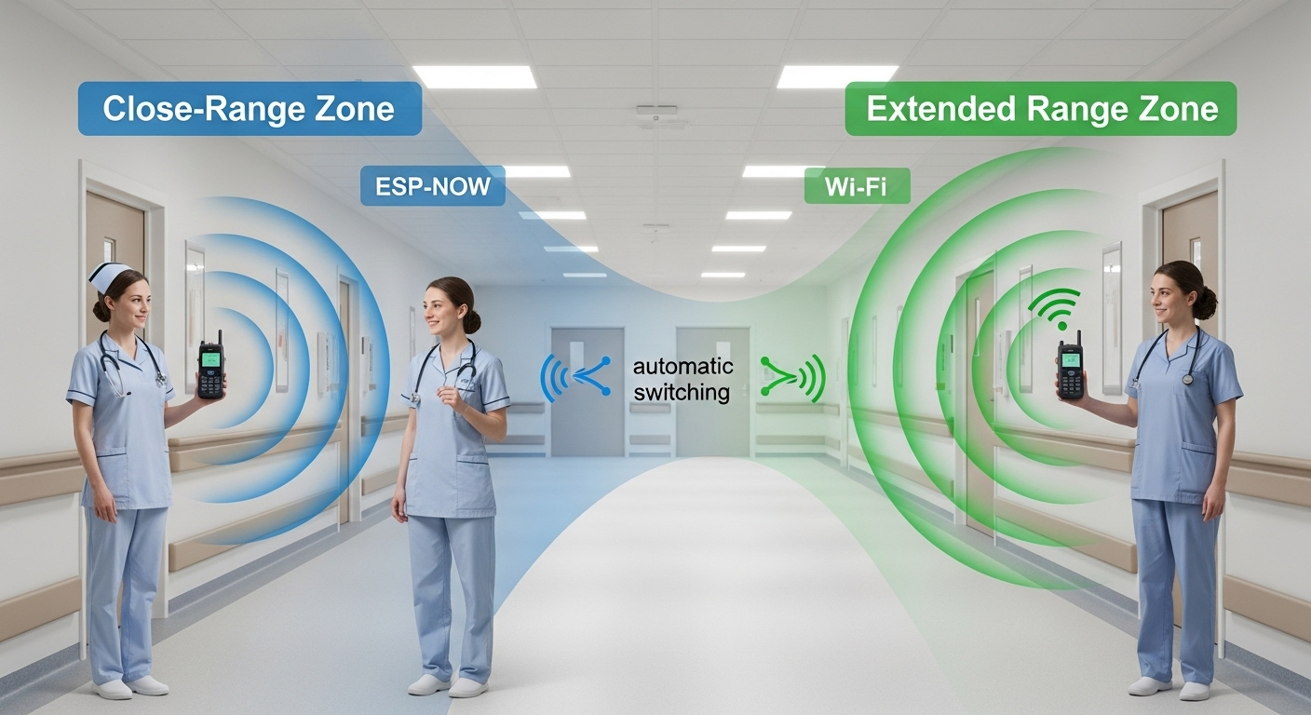
📡 ESP-NOW Protocol
🌐 Wi-Fi Connectivity
🔋 Power Management System
Used as a backup communication method when devices move beyond the ESP-NOW range. The system automatically switches to Wi-Fi to maintain continuous communication between nurse and patient devices.
💾 Embedded Firmware – Arduino IDE
🖥️ EasyEDA

Slide 14
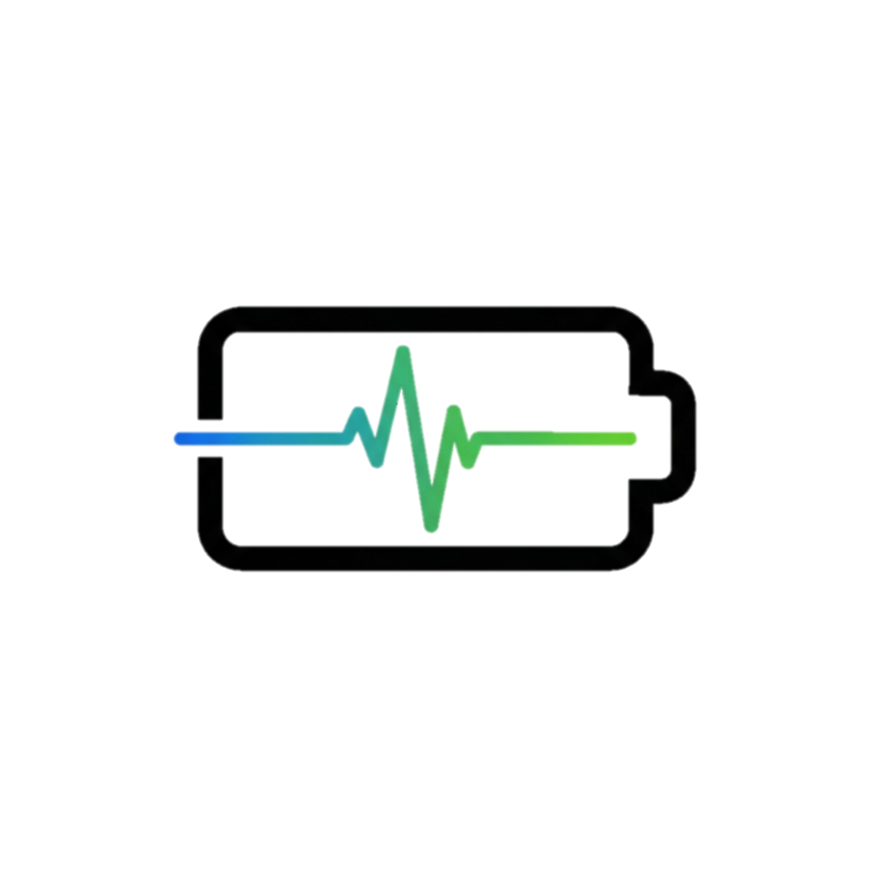
📡 ESP-NOW Protocol
🌐 Wi-Fi Connectivity
🔋 Power Management System
Incorporates battery monitoring and efficient power regulation to ensure long operation hours for wearable devices.
💾 Embedded Firmware – Arduino IDE
🖥️ EasyEDA

Slide 15

📡 ESP-NOW Protocol
🌐 Wi-Fi Connectivity
🔋 Power Management System
Custom firmware developed for both master and slave devices manages data collection, communication, and alert logic.
💾 Embedded Firmware – Arduino IDE
🖥️ EasyEDA

Slide 16

📡 ESP-NOW Protocol
🌐 Wi-Fi Connectivity
🔋 Power Management System
The PCB and schematic are designed in EasyEDA, enabling compact, reliable, and production-ready hardware layouts.
💾 Embedded Firmware – Arduino IDE
🖥️ EasyEDA

Slide 17

Why it’s unique or Innovative ??

Slide 18
Enables direct peer-to-peer communication between multiple devices without the need for Wi-Fi, internet, or a router.
🔗 ESP-NOW Protocol Integration:

Slide 19
⚡ Ultra-Low Latency Communication
The ESP-NOW protocol provides instant data transfer with minimal delay — crucial for real-time health monitoring and emergency alerts.

Slide 20
🔄 Smart Network Switching
The system automatically switches from ESP-NOW to Wi-Fi when the caretaker moves out of local range, ensuring continuous connectivity.

Slide 21
Combines the range of Wi-Fi and the speed of ESP-NOW, maintaining efficient data transmission in all conditions.
🌐 Hybrid Communication Model

Slide 22
One master device (nurse) can communicate with multiple slave devices (patients) simultaneously, enabling centralized monitoring.
🧠 Multi-Device Support

Slide 23
💡 No Dependency on Internet
Vital alerts can be exchanged even without any external network, making it ideal for hospitals with limited or unstable Wi-Fi.

Slide 24
🔋 Energy Efficient Design
ESP-NOW consumes significantly less power compared to Wi-Fi or Bluetooth, extending battery life for continuous operation.

Slide 25
👥 1. Who are your target users?
Vital Watch is tailored for :
Elderly individuals living alone or in assisted care environments
Cardiac patients requiring continuous health monitoring post-discharge
Residents in rural/semi-urban areas with poor access to emergency medical services
Family caregivers and healthcare professionals who need remote vital tracking
Small clinics, old-age homes, and rural health centres seeking low-cost health IoT infrastructure

Slide 26
❗ 2. What pain point does this solve?
Vital Watch directly addresses critical real-world challenges:
Delayed response to cardiac anomalies in elderly or isolated individuals
Dependency on costly commercial wearables that require cloud subscriptions and reliable internet
Lack of offline-first monitoring solutions that work in no-network zones
Signal interference in medical environments, reducing monitoring reliability
Limited access to technical healthcare solutions in rural or low-resource settings

Slide 27
🧪 3. User Validation & Lab Testing Outcomes
We conducted extensive lab testing and functional validation to ensure the system meets real-world needs.
✅ ESP-NOW Protocol Validation:
Successfully tested all communication modes : One-to-One, One-to-Many, Many-to-One, and Many-to-Many
Achieved ultra-low latency communication with an average of 4msDesigned and tested a custom signal repeater to : Boost signal range
Mitigate interference from medical devices (e.g., ECG machines, defibrillators)
✅ Data Integrity & Security :
Implemented AES-128 encryption for ESP-NOW packet transmission
Developed a packet counter system to track and detect any data loss in transmission
Verified lossless transmission under typical operating conditions.
✅ Hybrid Communication Mode:
Tested and validated smart switching:
In-range → uses ESP-NOW
Out-of-range → automatically switches to Wi-Fi or GSM mode
Ensures continuous data transmission even during connectivity fluctuations.
✅ Dashboard Display & Monitoring:
Successfully pushed live data (ECG, SpO₂, HR) to a real-time web dashboard
Displayed packet transmission status and error logs for debugging and quality control
Verified local + remote visualization of vitals and alerts🧑‍⚕️

Slide 28
⚙️ 1. System Overview
Our Vital Watch is a wearable IoT health monitoring system that continuously tracks patient vitals (like heart rate, temperature, SpO₂, etc.) and sends them to a centralized monitoring platform accessible to nurses and doctors.
Deployment has to cover three layers:
Device Layer (Edge)
Communication Layer (Network & Cloud Integration)
Application Layer (Frontend & Analytics)

Slide 29
🧩 2. Deployment Architecture
A. Device Layer (Edge Devices)
Hardware: Vital Watch (ESP32 + sensors for HR, Temp, SpO₂ + battery + Bluetooth/WiFi/GSM module)
Firmware: Real-time data acquisition + local threshold alerts + data packaging (JSON/MQTT format)
Power Management: Smart sleep cycles + regulated battery usage to ensure 24+ hrs operation
B. Communication Layer (Gateway & Network)
Option 1: WiFi → Hospital Local Server / Cloud
Option 2: GSM (via EC200U) → Cloud (MQTT/HTTPS)
Protocol: MQTT (lightweight, reliable for IoT) or HTTPS REST API
Data Flow: Watch → MQTT Broker → Cloud Database → Dashboard/API
C. Application Layer
Backend (Server): Python Flask / Node.js / Firebase Functions to manage API requests, authentication, and alert triggers.
Database: Firebase / MongoDB Atlas / AWS DynamoDB for real-time data sync.
Frontend (Dashboard): Web App for Nurses & Doctors (React / Angular / Flutter Web)

Slide 30
☁️ 3. Cloud Deployment Flow
Device publishes vitals → MQTT Broker
Broker → Cloud Function → Database
Database → Web Dashboard (via WebSocket/Firebase Real-time sync)
Alert Engine → Doctor/Nurse via SMS/Email/Push
🔐 4. Security & Reliability
TLS encryption for MQTT/HTTPS
Device authentication with tokens or certificates
Redundant cloud functions to prevent downtime
Daily backups of patient data (HIPAA-compliant if scaled)
🧠 5. Optional Add-ons
AI/ML layer: Predict abnormal conditions early using cloud-based analytics
Mobile App: For on-the-go monitoring
Offline Mode: Local data caching in gateway during outage
d-ons

Slide 31
🏗️ 6. Deployment Plan (Step-by-Step Rollout)
Phase | Objective | Tasks
Phase 1: Prototype | Single patient demo | Connect watch → MQTT Broker → Web dashboard
Phase 2: Local Deployment | 5–10 watches in hospital test | Deploy on local server or Firebase; test alerts & reliability
Phase 3: Cloud Scaling | Multi-ward deployment | Move backend to AWS/Firebase; enable remote monitoring
Phase 4: Production | Full hospital integration | Add redundancy, user management, analytics, mobile app

Slide 32
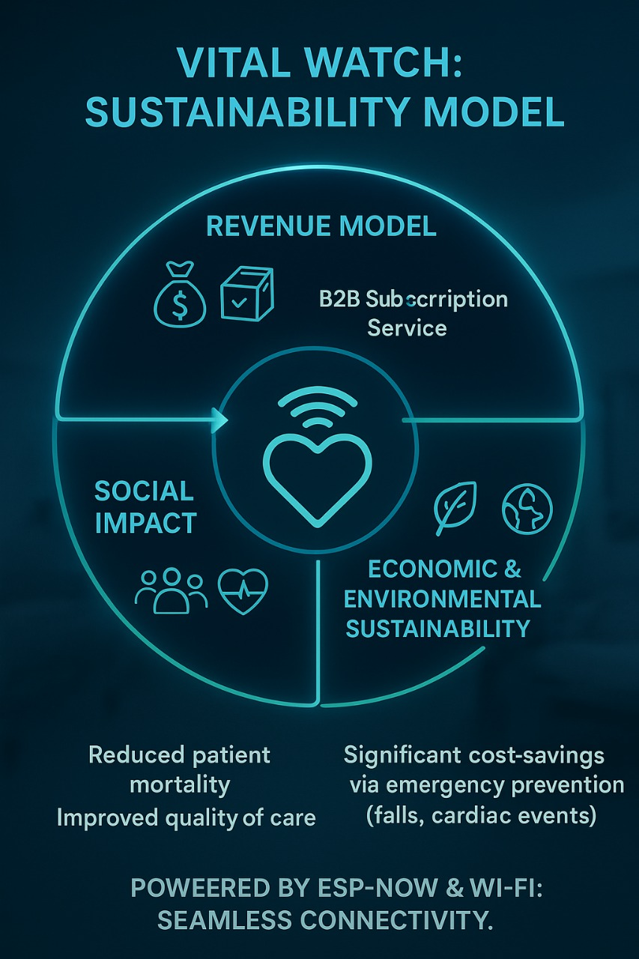
1. Revenue Model / Impact Model
Primary Model: B2B Subscription Service (Hospitals/Care Homes).
Pricing: Monthly/Annual fee per patient monitored.
Value Proposition: Significant cost-savings via emergency prevention (falls, cardiac events).
Social Impact: Reduced patient mortality and improved quality of care (our core non-monetary value).

Slide 33
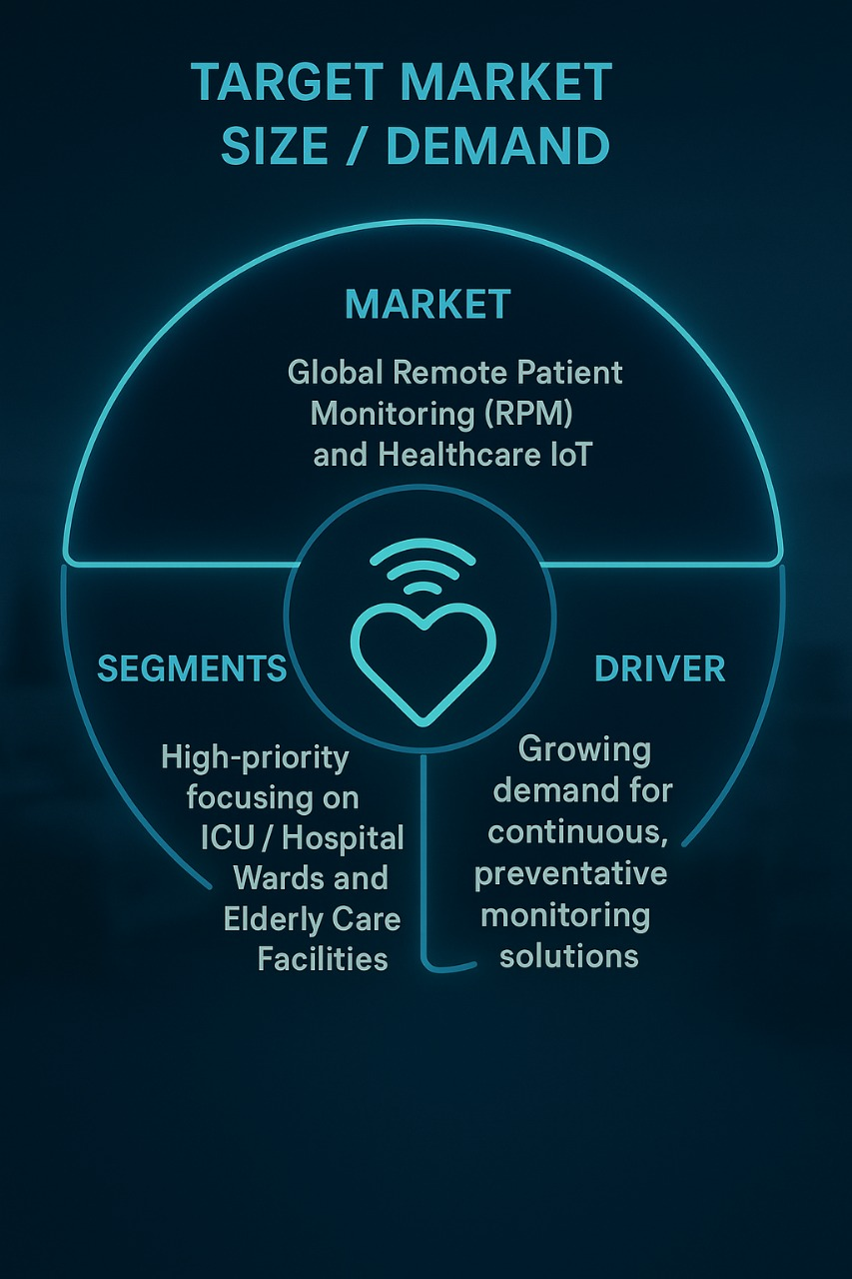
2. Target Market Size / Demand
Market: Global Remote Patient Monitoring (RPM) and Healthcare IoT.
Segments : High-priority focusing on ICU/Hospital Wards and Elderly Care Facilities.
Driver: Growing demand for continuous, preventative monitoring solutions.

Slide 34
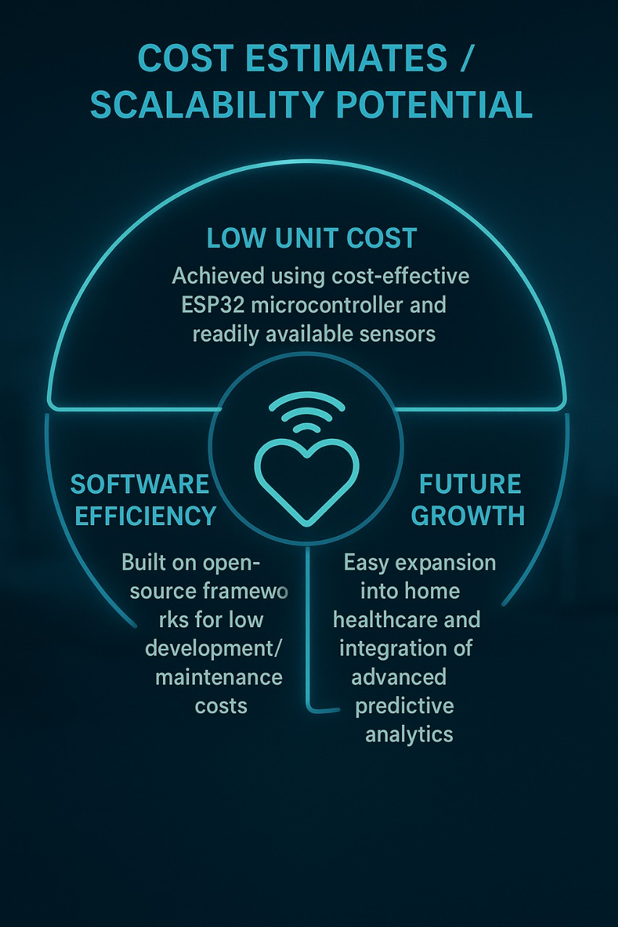
Cost Estimates / Scalability Potential
Low Unit Cost: Achieved using cost-effective ESP32 microcontroller and readily available sensors.
Software Efficiency: Built on open-source frameworks for low development/maintenance costs.
Scalability: Highly scalable due to our modular architecture and dual-mode communication (ESP-NOW mesh + Wi-Fi cloud).
Future Growth: Easy expansion into home healthcare and integration of advanced predictive analytics.

Slide 35
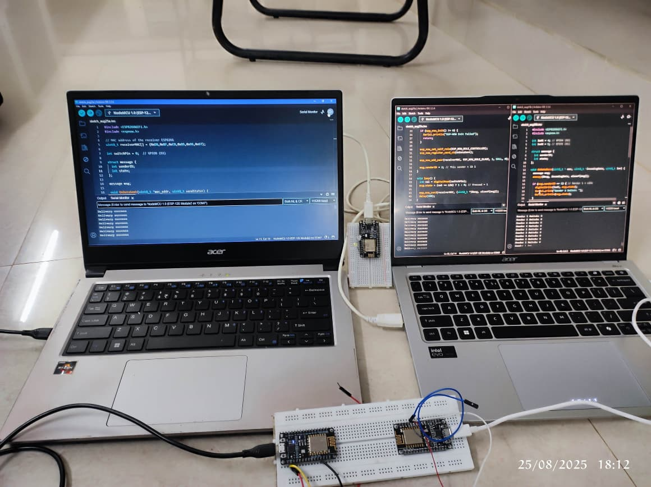
TESTING ESP-NOW PROTOCOL – MANY TO ONE

Slide 36
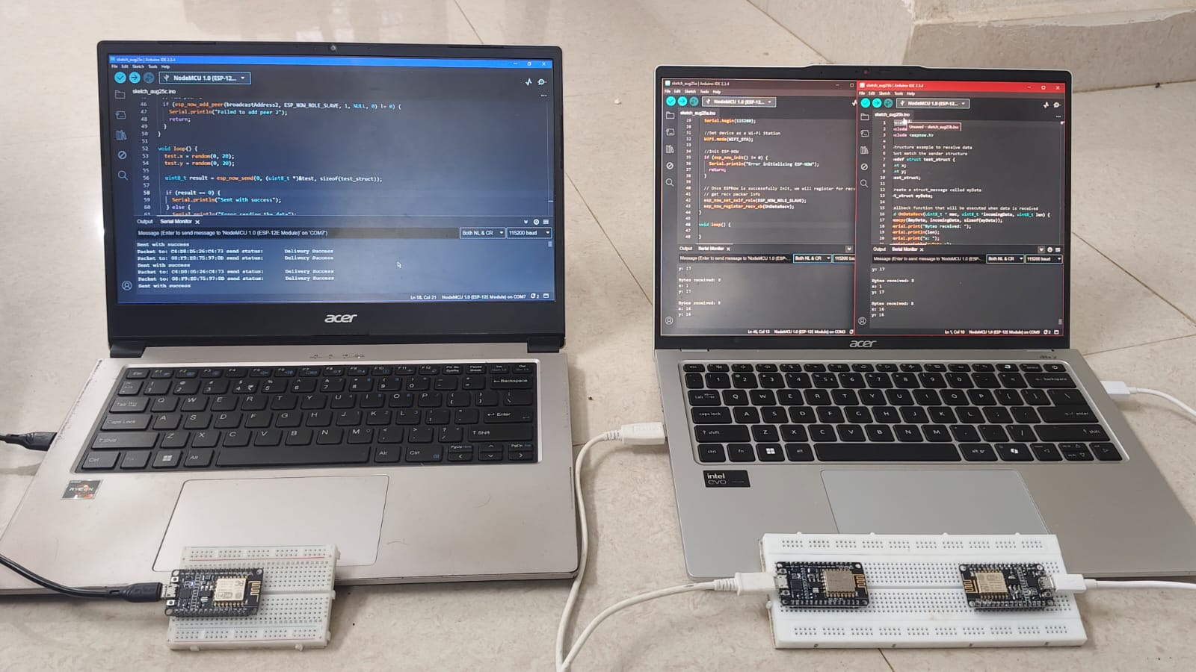
TESTING ESP-NOW PROTOCOL – ONE TO MANY

Slide 37
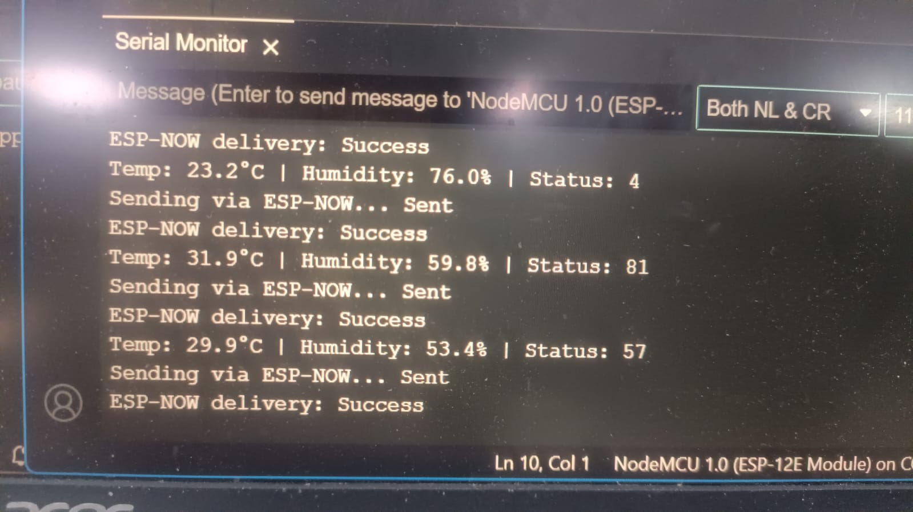
RECIEVING SENSOR DATA USING ESP NOW PROTOCOL

Slide 38
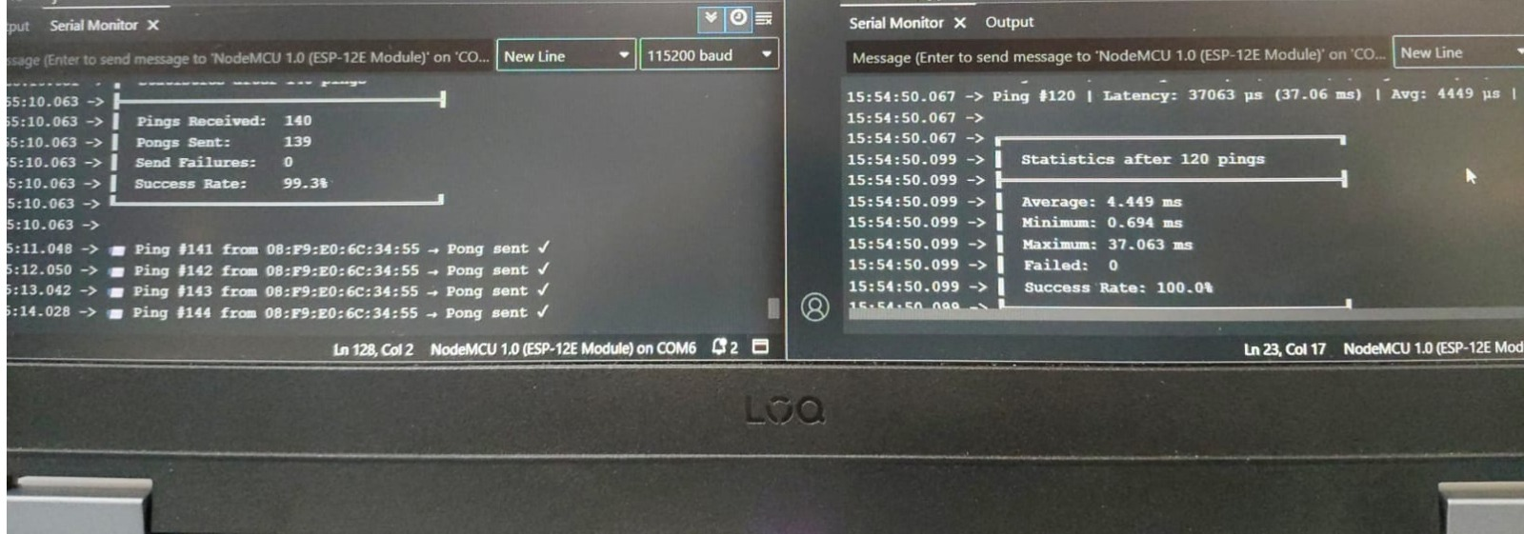
TESTING LATENCY OF ESP-NOW PROTOCOL

Slide 39
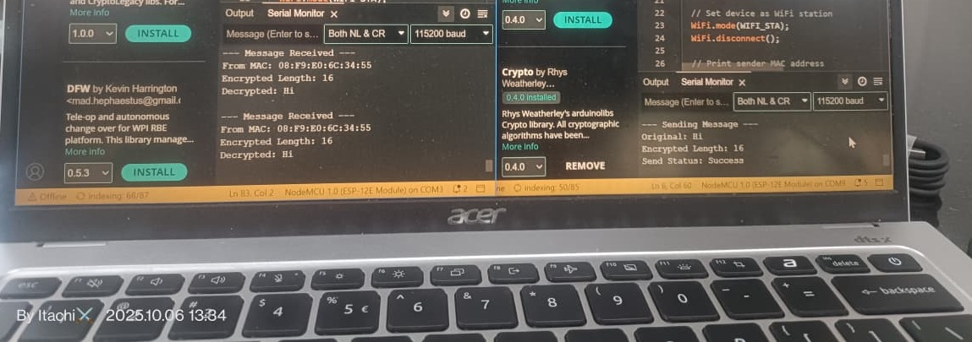

Slide 40
ROADMAP :
Functional prototype of Vital Watch with ECG, SpO₂, heart rate, and pressure monitoring.
Custom-designed PCBs for both the wearable device and hub station.
ESP-NOW protocol tested in all modes: one-to-one, one-to-many, many-to-one, many-to-many.
Achieved low-latency communication with an average delay of ~4 ms.
Developed and tested repeater module to boost signal and reduce interference from medical equipment
Implemented AES-128 encryption for secure data transfer.
Hybrid connectivity switching validated: ESP-NOW to Wi-Fi to GSM.
Real-time dashboard with live vitals, packet count, and transmission monitoring.
Local alert system (buzzer/vibration) and remote SMS-based emergency alerts

Slide 41
Next 30 Days :
Next 90 Days :
Field testing with elderly users and rural clinics.
BLE integration for Android app connectivity.
PCB size and power optimization.
Add fall detection (MPU6050) and GPS-based alerts
Large-scale pilot with 30–50 users
Begin regulatory documentation and pre-compliance testing
Long-Term Vision.
Scale deployment in rural health centers and old-age homes
Integrate cloud-based AI analytics for predictive health insights.
Launch full-feature mobile app for caregivers and hospitals
Develop LoRaWAN-based variant for remote and low-connectivity regions.
Align with national digital health and telemedicine initiatives.
Next 60 Days :
TinyML-based arrhythmia detection integration.
Android app development.
Battery life testing and improvement.

Slide 42





🫂 TEAM & ROLES
AKASH VARMA
as
TEAM LEAD
PRANAV SAI
as
R&D ENGINEER
SURYA TEJA
as
HARDWARE ENGINEER
HARSHA VARDHAN
as
TESTING ENGINEER

Slide 43
AKASH VARMA
PRANAV SAI
SURYA TEJA
HARSHA VARDHAN
as
TEAM LEAD
as
R&D ENGINEER
as
HARDWARE ENGINEER
as
TESTING ENGINEER

Slide 44
Background / Credentials :
Our team has been dedicated to the Vital Watch Project for over a year, focusing on hardware innovation, embedded systems design, and real-time health monitoring solutions. We had the privilege of presenting our idea at the World Health Innovation Forum (WHIF), where it gained appreciation from doctors, researchers, and industrial experts from over 50 countries .We come from an Electronics and Communication Engineering background and have gained deep practical knowledge through industrial internships and training programs focused on embedded systems and IoT development. Our continuous R&D efforts have allowed us to develop custom hardware solutions — including PCB design, sensor interfacing, wireless data communication, and power-efficient embedded architectures.

Slide 45
Why This Team is Capable of Executing the Project :
Our team possesses strong technical expertise in hardware design, embedded firmware development, and communication systems. We have successfully built multiple working prototypes of Vital Watch, integrating ESP-NOW and WiFi hybrid communication, AES-128 data encryption, and optimized power management circuits for continuous patient monitoring. Through our industrial training experiences, we’ve learned to approach problems from both engineering and product development perspectives — ensuring our solutions are not only functional but also reliable for real-world deployment. Our proven capability in designing, testing, and refining embedded hardware makes us fully equipped to execute and scale this project efficiently.

Slide 46
ASK
We are seeking mentorship, technical collaboration, and funding support to take Vital Watch from a working prototype to a fully deployable healthcare solution.
Mentorship: Guidance from embedded system experts and medical device professionals to refine our design for clinical reliability and large-scale deployment.
Funding Support: To develop production-grade PCBs, perform advanced testing, and integrate cloud-based monitoring infrastructure.
Partnerships: Collaboration with healthcare institutions and IoT companies to pilot Vital Watch in real hospital environments.
Feedback: Insights from judges and domain experts to strengthen our device’s usability, performance, and data security.
With your support, Vital Watch can evolve into an affordable, real-time health monitoring network that truly empowers hospitals and caregivers.

